Slide 1
DT Slide Worksheets
Winter 2022
TEAM CS1XD3

Slide 2
Watch the DT video

Slide 3
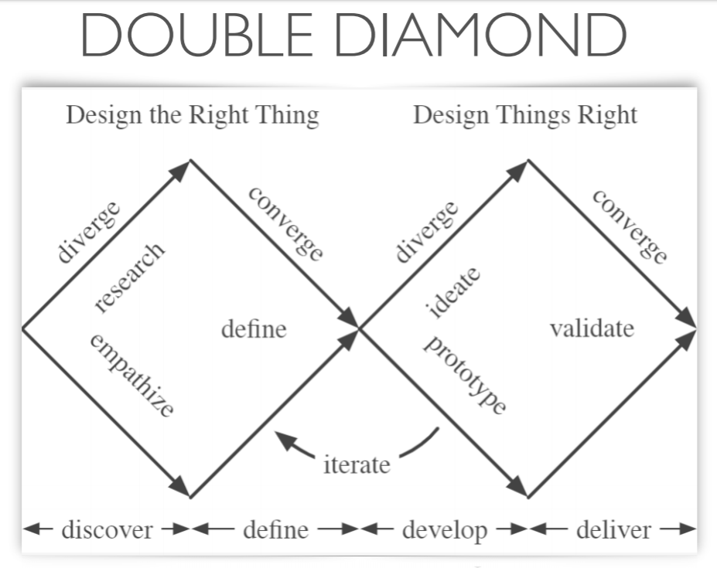
Notes:
https://macoutreach.rocks/DT.html

Slide 4
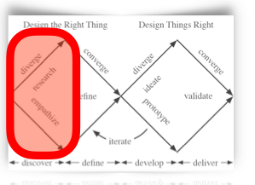
Possible Project Areas
What do they need to know? Who are they? Who will you find to interview?
Discrete mathematics - Truth Table Generator
Linear algebra - Vector addition and Transformation Visualizer
Calculus – derivative calculator/integral calculator
Mathematical reasoning – euclidean shape visualizer (specific to euclidean math rules)
Notes:
Estimated Time:
Details: This is the stage where you are tackling the first diamond: figuring out

Slide 5
Option 1 Research
Discrete mathematics - Truth Table Generator​
What could we find out about option 1? - In our discrete math course.
Is it something people find hard to learn? - It's a little bit hard to learn, but it will be hard to generate truth tables in markdown.
Why do people need to know it? (Will they be motivated by applications?) - Students' lives would be better if they have this generator to help with their learning and homework
Is there a good visualization component? - Yes
How will we find people to interview? - We'll find our professor and classmates to interview.
Notes:
Estimated Time:
Details: This is the stage where you are tackling the first diamond: figuring out

Slide 6
Option 2 Research
Linear algebra - Vector addition and Transformation Visualizer
What could we find out about option 2? - Linear algebra involves the addition and transformation of 2d vectors.
Is it something people find hard to learn? - Some people may find it difficult to visualize the sum of vectors and transformations applied on vectors geometrically in a 2d plane.
Why do people need to know it? (Will they be motivated by applications?) - If you can visualize how vectors are manipulated, you will gain a more intuitive understanding of it
Is there a good visualization component? - Yes to visualize the manipulation of vectors, you have to display how the vectors change.
How will we find people to interview? - Many computer science students have taken a linear algebra course so there are many students we can contact who are experienced with linear algebra.
Notes:
Estimated Time:
Details: This is the stage where you are tackling the first diamond: figuring out

Slide 7
Option 3 Research
Calculus – derivative calculator/integral calculator
What could we find out about option 3? - Grade 12 Calculus class and Math 1ZA3
Is it something people find hard to learn? - Yes, derivatives have many different approaches and steps that can be taken, and often people will get lost on where to start or make mistakes in between
Why do people need to know it? (Will they be motivated by applications?) - Solving math problems efficiently (ie. Optimization)
Is there a good visualization component? - Not really, would be very difficult to graph the functions as a whole
How will we find people to interview? - Calculus teachers know all the secrets about calculus + students (for opinions about what they struggle with)
Notes:
Estimated Time:
Details: This is the stage where you are tackling the first diamond: figuring out

Slide 8
Our Focus
Linear algebra - Vector addition and Transformation Visualizer
Target users: first year undergraduate university engineering students / math and stats students
General problem area: linear algebra learning with visual presentation to assist understanding
Notes:
Estimated Time:
Details: This is the stage where you are tackling the first diamond: figuring out

Slide 9
Questions to Ask
Have you taken or are taking linear algebra? How do you feel about transformations on 2D vectors? Is it difficult to visualize?
Do you find scalar addition/ multiplication/ span/ transpose/ inverse/ determinant hard to deal with?
Does visualizing the graph of the transformed vector help your understanding of transformations?
What are things you dislike about learning about vector transformations?
Which part of vector transformations do you struggle the most with?
Would it help your understanding if you were able to visualize how transformations transform the actual shape of the graph?
If you were to design a vector transformation app, what would be the main things you would include?
Notes:
Estimated Time:
Details: This is the stage where you are tackling the first diamond: figuring out

Slide 10
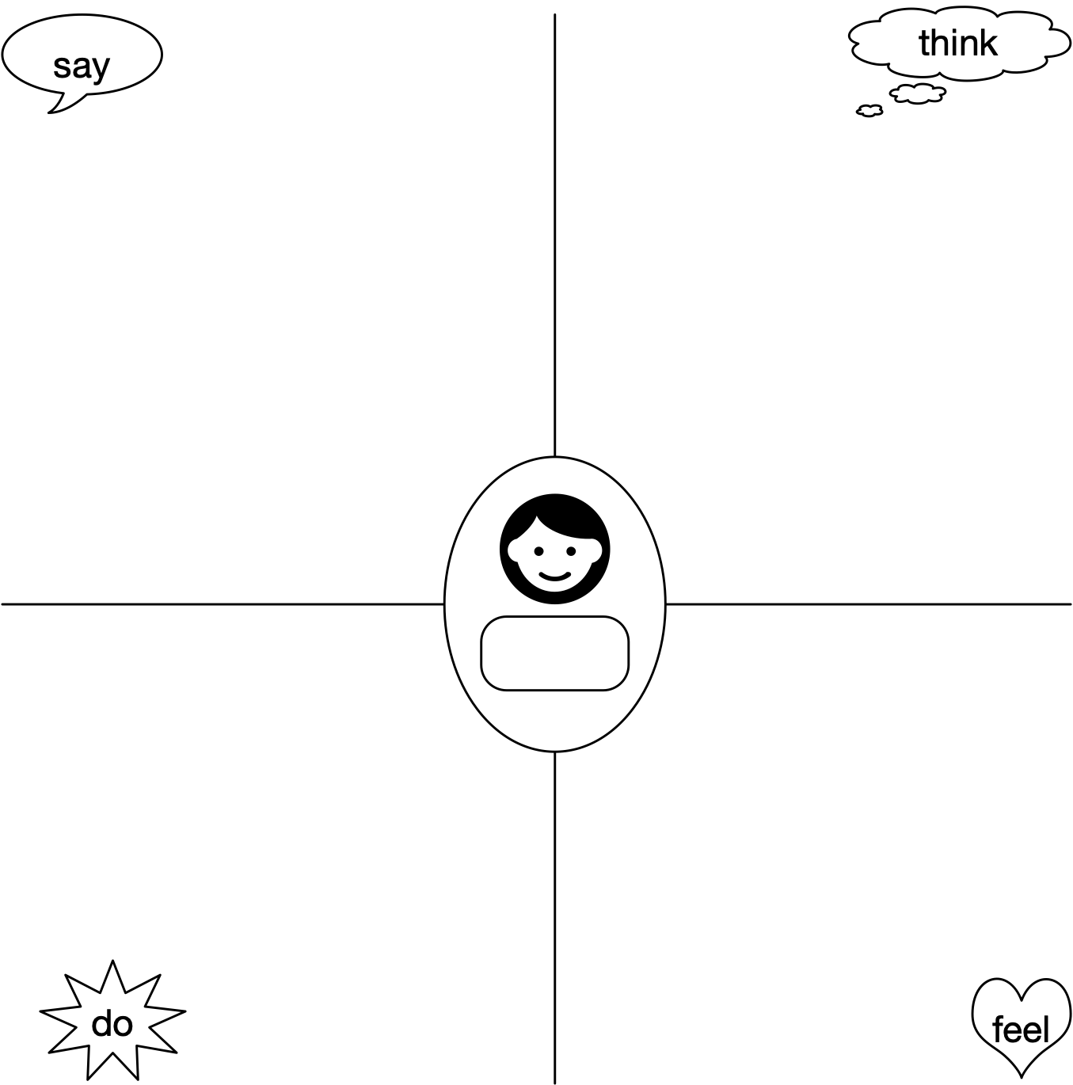
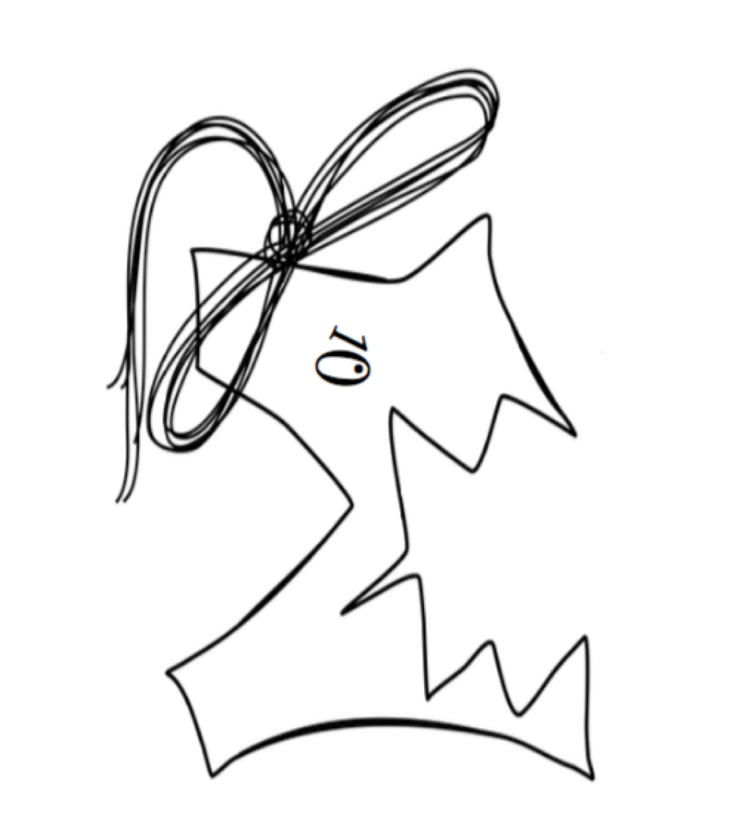
Interview 1
Empathy Map:
Use to take notes when interviewing/shadowing individual users, and again when creating a fictional target user. Have one person do the talking, and a second take notes, but steer the conversation to cover all 4 areas.
say: What they say in response to questions or volunteer.
think: Things you infer about their knowledge or opinions, because they avoid a topic or direct answers, are surprised by or do not understand some questions.
do: Steps they take in doing a task, either observed from shadowing, or noted when they describe how they do their work.
feel: Things you infer about their feelings, such as whether they would enjoy using a proposed solution, or would prefer the way things work now.
Practice slides will have blue blue gradient backgrounds.
- while he completed the course, it was pretty straight forward, but when solving the questions he had to look at his notes multiple times
- having visualization would help on understanding vector transformations
- when connecting random dots on paper to draw vectors in 2 dimension, it was okay but when taking a vector to another space/dimension, drawing the 3d space was difficult, especially 4d and 5d
- if he had a visual representation of vectors in multiple dimensions, it would be much easier to understand
It would be much more easier to learn transformations based on computer visualization
- we think that he struggled a lot in the course/did not like the course, because when we asked him what he did not like about the course, he became very passionate
HOW TO IMPROVE QUESTIONS:
- improve questions - he spoke from a student perspective, change questions to ask about the teachers perspective and how he felt about teaching concepts that were difficult to students
- he said we covered it all
- if we asked about what he would like to help him understand linear algebra more, he would then talk about the basic logic of the calculator
This info
- watched videos multiple times to understand the basic concepts of transformations
- create a basic interface, create separate buttons for a normal calculator (create options for addition, subtraction, multiplication, scaling vectors), update vector button, create a separate button that leads you to a transformation interface where you can see the transformation on screen
Team
Feel difficult to learn matrix transformation
struggled the most on visualizing matrices transforming to different dimensions above 3D (R^n, as n gets greater)
- hard to follow the rotation matrices without a visual representation (he was able to solve the question but couldn't grasp the entire concept without a visual representation)
This info
This info
1

Slide 11
Interview Skills: Fill this out after empathy map interview for your group. Highlight your choices.
Did you… | circle one
set up interview, giving context? | Somewhat | Yes | Definitely!
make them comfortable? | Somewhat | Yes | Definitely!
ask open-ended questions? | Never | Sometimes | Whenever appropriate
Ask follow-ups? | Never | Sometimes | Whenever appropriate
Ask how they felt about things? | Never | Sometimes | Whenever appropriate
Ask for stories, or to describe the steps of a job? | Never | Sometimes | Whenever appropriate
React to non-verbal clues they were uncomfortable, wanted to say more, etc? | Never | Sometimes | Always

Slide 12
Revised Questions
Have you taken or are taking linear algebra?
What was the hardest concept for you to grasp in linear algebra?
Do you find scalar addition/ multiplication/ span/ transpose/ inverse/ determinant hard to deal with?
Does visualizing the graph of the transformed vector help your understanding of transformations?
What are things you dislike about learning about vector transformations?
Which part of vector transformations do you struggle the most with?
Would it help your understanding if you were able to visualize how transformations transform the actual shape of the graph?
If you were to design a vector transformation app, what would be the main things you would include?
Was it difficult to teach transformations to students? - Would it help if there was a visual component that you could use to support your teachings?
What did you find students struggling to grasp the most when teaching linear algebra?
Notes:
Estimated Time:
Details: This is the stage where you are tackling the first diamond: figuring out

Slide 13
Questions for TA
Can you provide any advice on our interview questions? Our interviewee didn't have anything to say about them...
How can we get more feedback? Often, when we ask them for feedback the interviewee will say they thought everything was great.....we try to ask them to expand but they don't say anything....help please

Slide 14
Week 2 Feedback
By next week, you should interview four potential users of your app.

Slide 15
Interview 1
Empathy Map:
Use to take notes when interviewing/shadowing individual users, and again when creating a fictional target user. Have one person do the talking, and a second take notes, but steer the conversation to cover all 4 areas.
say: What they say in response to questions or volunteer.
think: Things you infer about their knowledge or opinions, because they avoid a topic or direct answers, are surprised by or do not understand some questions.
do: Steps they take in doing a task, either observed from shadowing, or noted when they describe how they do their work.
feel: Things you infer about their feelings, such as whether they would enjoy using a proposed solution, or would prefer the way things work now.
He has taken linear algebra
2d vector visualizer isn't that bad but vector spaces are difficult to understand
If you were a freshman going into linear algebra and you were learning vector transformations, you would need to learn and understand matrices in order to understand vector transformations
You have to remember too many things to graph the transformation, how the vector changes with different transformation, hard to memorize, if he cold visualize each transformation it would be much easier to remember + comprehend He learned the transformations through the visual images in the textbook as compared to the words (thus: visualizing plays a major role in understanding) App includes how to calculate the determinant, inverse, type of matrix (show you what the graph looks like: ex scalar multiplication) shows you span
first year who has taken linear algebra: Frank's roommate
This info
Doesn't know what b coordinates are when asked, looks very confused even after explanation
Linear algebra is the hardest class he's ever taken FOR SURE (proceeds to nervously laugh)
This info
This info
Run me through the steps of how to solve for the determinant for a 2*2 matrix: ad-bc
Team
Visualizing things always helps to further understand concepts - if there were visuals to accompany the explanation of b vectors, it may be easier to grasp the concept
1

Slide 16
- Shear or inflection of the matrix is hard to imagine - transposing is simple because you're just flipping things in the matrix - hard to learn the inverse of a matrix, especially when it comes to visualizing it
Things they would like in a vector transformation app: - some kind of transformation where you are able to change the vector and see the entire grid - the ability to chain the transformations together and show the final transformation/final vector if you were a ta, and you were teaching transformations would it help to visually show it? - yes it would help because it emphasizes the idea that transformations have a visual component to them and are not just a random multiplication that are applied to vectors - eigenvector and eigenvalues with visuals are much more easy to understand
Interview 2
Empathy Map:
Use to take notes when interviewing/shadowing individual users, and again when creating a fictional target user. Have one person do the talking, and a second take notes, but steer the conversation to cover all 4 areas.
say: What they say in response to questions or volunteer.
think: Things you infer about their knowledge or opinions, because they avoid a topic or direct answers, are surprised by or do not understand some questions.
do: Steps they take in doing a task, either observed from shadowing, or noted when they describe how they do their work.
feel: Things you infer about their feelings, such as whether they would enjoy using a proposed solution, or would prefer the way things work now.
first year who has taken linear algebra: Nick T.
Seems interested in how to graph vector transformations, wants to know more about how we plan to do it (which makes sense because they're interested in computer graphics)
Make a dark mode for the grid
When he heard its going to written in elm, he said it makes it 10x harder (as compared to a language such as python)
Took him a while to answer when we asked him if he could visualize the span of a matrix (confusion)
This info
Finding the determinant of a 2x2 matrix is simply calculating the area of the parallelogram
Team
Enjoy watching youtuber 3blue 1 brown showing visually how the vector transformation is done to help understanding
Coordinate systems would be difficult to understand for a beginner because converting from one vector to another is difficult because you need to take the inverse, which he thought was counterintuitive
Visualizing transformations would help to further understand the concept because seeing a visual representation of what's going on allows you to understand it visually and will make it easier to remember and recognize the transformation next time it is seen, making transformations more intuitive, memorable and applicable
Hard to compute vector transformation by hand.
This info
1

Slide 17
Interview Skills: Fill this out after empathy map interview for your group. Highlight your choices.
Did you… | circle one
set up interview, giving context? | Somewhat | Yes | Definitely!
make them comfortable? | Somewhat | Yes | Definitely!
ask open-ended questions? | Never | Sometimes | Whenever appropriate
Ask follow-ups? | Never | Sometimes | Whenever appropriate
Ask how they felt about things? | Never | Sometimes | Whenever appropriate
Ask for stories, or to describe the steps of a job? | Never | Sometimes | Whenever appropriate
React to non-verbal clues they were uncomfortable, wanted to say more, etc? | Never | Sometimes | Always

Slide 18
Interview 3
Empathy Map:
Use to take notes when interviewing/shadowing individual users, and again when creating a fictional target user. Have one person do the talking, and a second take notes, but steer the conversation to cover all 4 areas.
say: What they say in response to questions or volunteer.
think: Things you infer about their knowledge or opinions, because they avoid a topic or direct answers, are surprised by or do not understand some questions.
do: Steps they take in doing a task, either observed from shadowing, or noted when they describe how they do their work.
feel: Things you infer about their feelings, such as whether they would enjoy using a proposed solution, or would prefer the way things work now.
Has already took linear algebra last semester, because it was his required course.
it's easy to make transformations in 2D vectors. (including the visualize)
scalar addition/ multiplication/ span/ transpose/ inverse. For these concepts, it would be acceptable if they were separated out individually but combining them would be confusing and the difficulty would increase a lot.
For making an app yourself: 1. Want to make a software that can quickly find concepts by entering keywords 2. Want to make a software that can visualize linear transformations directly
In addition to passing the lecture of the professor, will also watch 3Blue1Brown's videos on YouTube.
first year who has taken linear algebra: Simon's roommate
Can't remember which part of the vector transformations he struggled with, but he was confused by what he learned in the two weeks after midterm
Didn't like the teaching mode of last semester very much. he thought it was all about concepts and there were few examples
Team
Throughout the course, visualization helped him greatly in understanding concepts and questions.
would watch pre-lectures and lectures over and over again to make sure he had a good grasp of these concepts
1

Slide 19
Interview 4
Empathy Map:
Use to take notes when interviewing/shadowing individual users, and again when creating a fictional target user. Have one person do the talking, and a second take notes, but steer the conversation to cover all 4 areas.
say: What they say in response to questions or volunteer.
think: Things you infer about their knowledge or opinions, because they avoid a topic or direct answers, are surprised by or do not understand some questions.
do: Steps they take in doing a task, either observed from shadowing, or noted when they describe how they do their work.
feel: Things you infer about their feelings, such as whether they would enjoy using a proposed solution, or would prefer the way things work now.
1B03 was the first time he taught linear algebra last semester
Any time you can provide a visual representation such as graphs or pictures to enhance learning by providing visuals is a good idea
main thing that first years tend to struggle with is taking the vector transformations they are learning and tying them to something physical that they can actually understand, such as moving an object on a table and how that can be represented in the arithmetic - first year linear algebra course does not
main problem is that some of the intuitions you get about how transformations work are special in 2 or 3 dimensions and don’t generalize higher dimensions - ex: cross product is specific to 3D vectors
thing that is the most useful and hardest to make is something where you can draw vectors in 3D because you need to be able to drag and manipulate the space
Linear Algebra TA: Fletcher Gates
people don’t tend to dislike/like topics but it boils down to whether they find them easy or hard to understand
visualization apps are less helpful when working in abstract math as it takes time to build intuition
given a set of vectors, you need to have a friendly user interface that tells you interesting things about those vectors
By the end of the course, first year students may feel like they learned something that doesn't relate to something they care about
This info
This info
provide a set of vectors in R3 and provide as much useful information about them - ex: volume of a parallelepiped is a group of vectors linearly dependent/independent; if dependent, provide an example of where they are linearly dependent where they add to 0, if you were to use a set of independent vectors, provide a change of basis matrix
Team
main problem with freely available linear algebra tools is that everything is out there but are not combined into a single app (annoying to have to use multiple different software's for different transformations)
When providing visuals, it is important to make sure that the visuals are not misleading to prove intuition
Something that caused the most confusion were the abstract vector space questions
First year linear algebra course does not develop the understanding/connection between arithmetic on vectors and how it actually affects the vector visually/physically
This info
This info
1

Slide 20
Interview Skills: Fill this out after empathy map interview for your group. Highlight your choices.
Did you… | circle one
set up interview, giving context? | Somewhat | Yes | Definitely!
make them comfortable? | Somewhat | Yes | Definitely!
ask open-ended questions? | Never | Sometimes | Whenever appropriate
Ask follow-ups? | Never | Sometimes | Whenever appropriate
Ask how they felt about things? | Never | Sometimes | Whenever appropriate
Ask for stories, or to describe the steps of a job? | Never | Sometimes | Whenever appropriate
React to non-verbal clues they were uncomfortable, wanted to say more, etc? | Never | Sometimes | Always

Slide 21
Pivot or Not?
Was it easy to find potential users? -Yes, Engineering and math students all take linear algebra
Is there commonality among the user problems? - Yes, they typically all struggle with learning transformation just algebraically, without any graphical presentation.
Were interviewees excited about it? -They are excited to see the final project. One of them wanted us to send regular updates on its progress.
Were we excited about it? - Definitely not
Notes:
Estimated Time:
Details: This is the stage where you are tackling the first diamond: figuring out

Slide 22
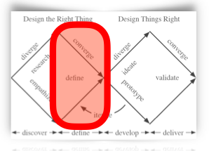
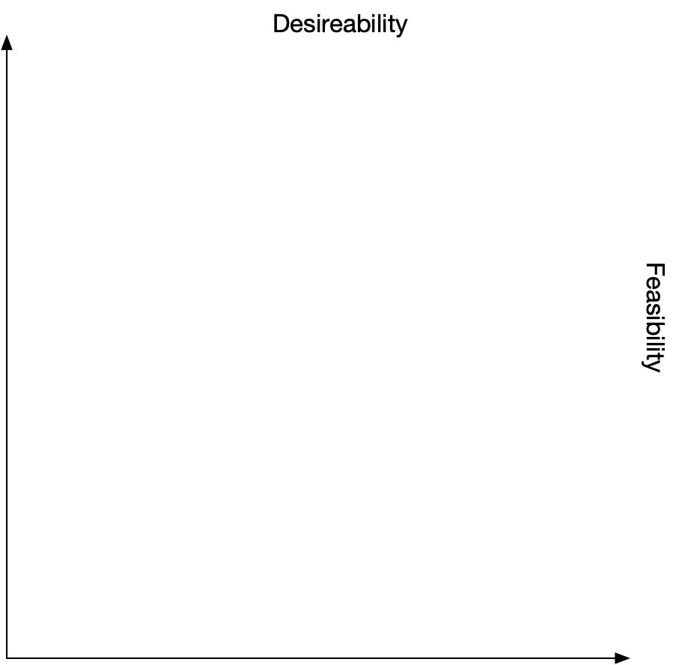
Problem Definition
1 | Crazy idea
2 | Hard to understand b-coordinates without visualizing it.
3 | Hard to understand and visualize the effect of matrix transformations
4 | Hard to visualize span
5 | Hard to memorize the matrices for different important transformations (e.g. sheer, inflection, etc,) without visuals
6 | Hard to understand and visualize eigen vectors and eigen values without visuals.
7 | Hard to visualize the composition between multiple different transformations,
8 | Some visualization apps don't have dark mode for those late night 5am study sessions
9 | Hand computation is tedious.
10 | Hard to visualize and understand the inverse of matrices.
11 | Hard to understand that vector addition and scalar multiplication isn't just random computation and that they have actual visual effects attributed to them(I.e.
12
13
14
15
Led to this
Impact
3
5
11
9
2
Novelty
7
4
10
6
8
How Might We?
As individuals in the group, write five to ten different ideas on a piece of paper, for how we could make our users’ lives better by reducing a problem or giving them a new opportunity.
As a group, take turns reading your ideas, and if they are very similar to other ideas, merge them together and write down one version of the idea in the table.
Again as a group, discuss the ideas in reverse order, and assign them potential Impact and Novelty scores by plotting the number on the scatter plot.
Pick the best overall statement or statements, and combine them into your goal, in the box below.
1
12
13
14
15
Drag these tags to the correct spot
use
We want to find a way to help
with
First year students taking linear algebra
Visualizing and understanding linear algebra concepts (mainly involving vectors)
need

Slide 23
Q&A
Write down questions raised by the HMW process. For example, if you identified fraction arithmetic as an area your users find confusing, what grade is it covered in in Ontario’s math curriculum? If PDEs cause your users trouble, what are they?
Led to this
Can the elm IDE handle vectors in 3 dimensions?
How different would the code be if we changed our vectors from 2 to 3 dimensions? Is it feasible to complete/attempt?
When thinking about creating a dark mode for our software, how many colours would we have to change in order to make the vectors and text stand out while keeping it aesthetically pleasing?
Some people find it harder to understand concepts without visuals, does this apply to the general population of first years taking linear algebra?
Led to this
Notes:
Estimated Time:
Details: This is the stage where you are tackling the first diamond: figuring out

Slide 24
Questions for TA
If you have questions for TAs put them on a pink gradient background. If you prefer, you can add a black slide for raw interview notes, and summarize them on the empathy map. If you have two note-takers, you could use two text boxes.

Slide 25
Week 3 Feedback
By next week, you should complete research to settle open questions around problem definition and to prepare for solution ideation. If you are settled on a problem which already has solutions, you should make a competitive chart to understand the weaknesses of existing solutions.

Slide 26
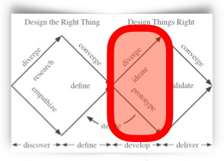
Solutions
Also led to this
1
2 | Create a GUI that can display vectors and their effects after various vector transformations in order to further understanding and comprehension
3 | Calculate inverses of matrices, and display it visually
4 | Create cheat sheet that includes vector transformations (descriptions and formulas to go along with each definition)
5 | Create a vector visualizer that has a dark mode
6 | Add a calculator to program so that user does not need to do any hand computations
7
8
9
10
11
12
13
14
15
7
2
3
6
4
15
5
1
14
8
9
10
11
12
13
Ideation:
As individuals in the group, write five to ten different solutions on a piece of paper.
Include an idea costing less than $1000 and one costing a million, include one using an app, and one without an app.
As a group, take turns reading your ideas, and if they are very similar to other ideas, merge them together and write down one version of the idea in the table.
Again as a group, discuss the ideas in reverse order, and assign then Desirability and Feasibility scores by plotting the number on the scatter plot.
Pick the best overall idea, and combine them into your goal, in the box below.
Drag these tags to the correct spot
Our goal is to help first year students taking linear algebra understand and comprehend vector transformations more through visuals

Slide 27
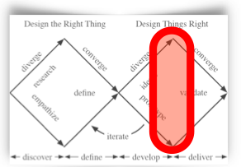
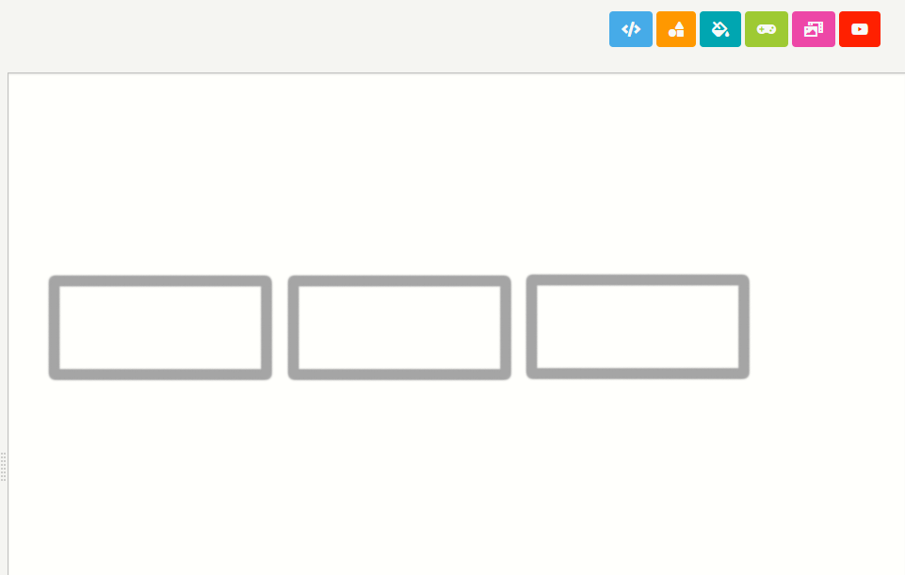
Prototype
1
homescreen
Clicked this button
vector addition
and
multiplication
vector transformations
cheat sheet

Slide 28
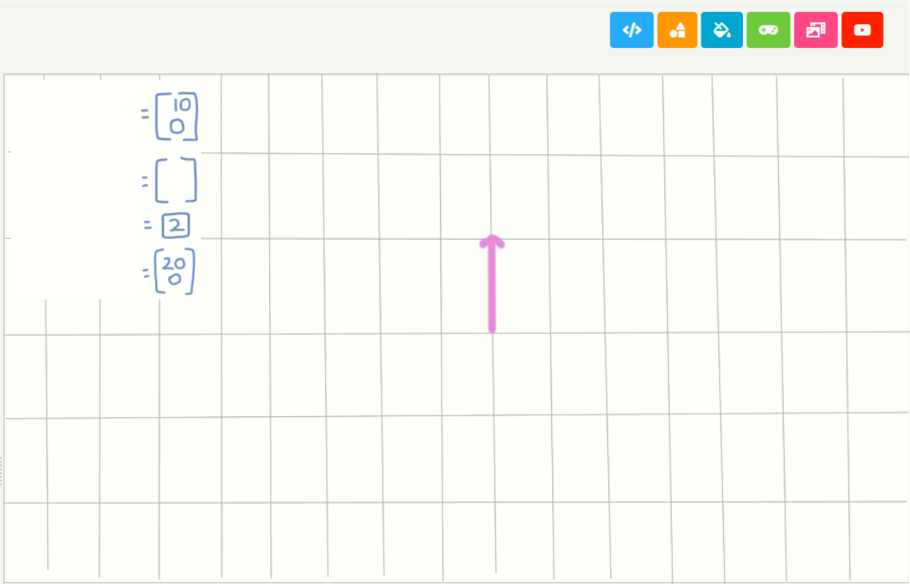
Prototype
1
Vector addition and multiplication screen
original vector
back
second vector
scalar value
resultant vector

Slide 29
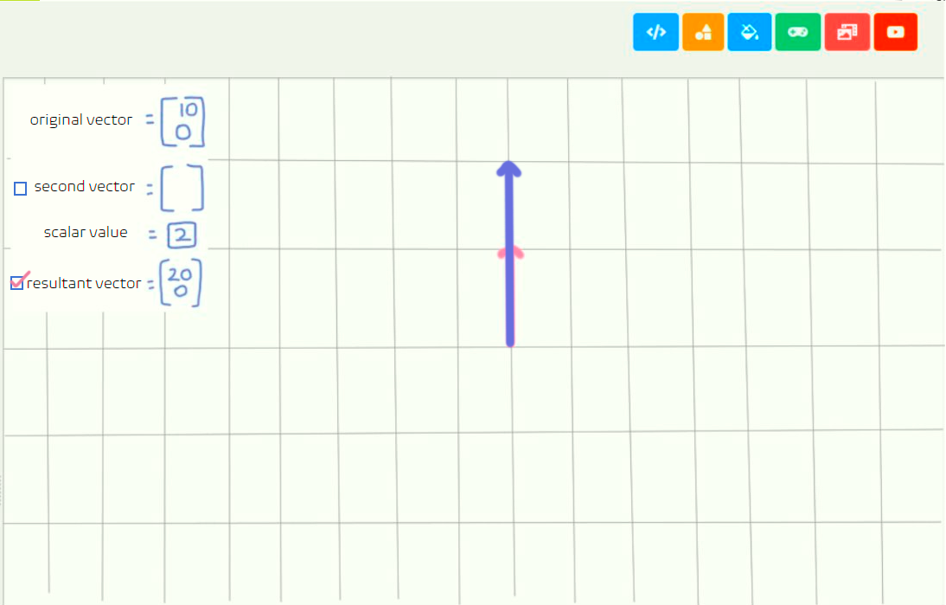
Prototype
1
Vector addition and multiplication screen
back
User ticks off box by clicking on it

Slide 30
Prototype
1
Vector addition and multiplication screen
back
User hits back button

Slide 31
Prototype
1
homescreen
Clicked this button
vector addition
and
multiplication
vector transformations
cheat sheet

Slide 32
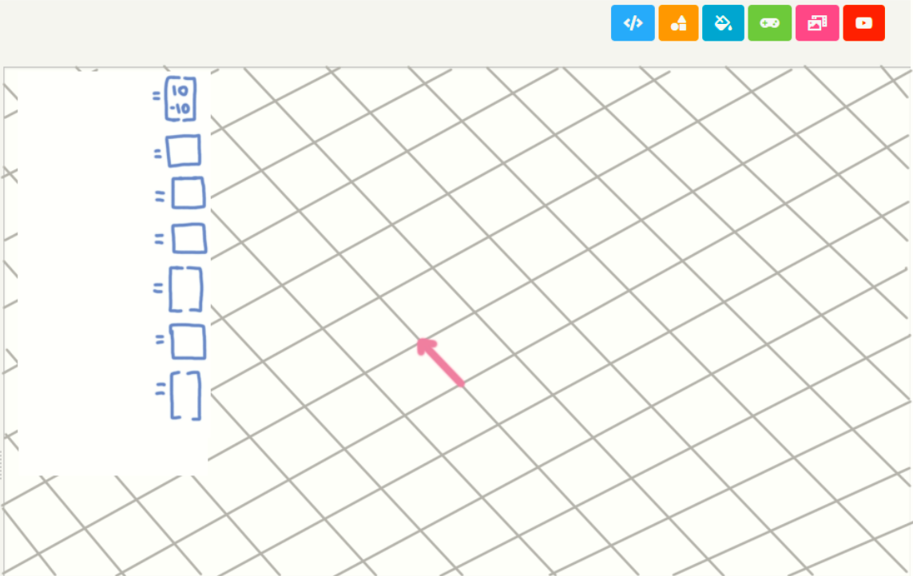
Prototype
1
Vector transformation screen
original vector
original vector
back
back
back
horizonal shear factor
horizonal shear factor
vertical shear factor
vertical shear factor
determinant
determinant
resultant vector
eigenvector
eigenvalue
second vector
x-axis reflection
y-axis reflection

Slide 33
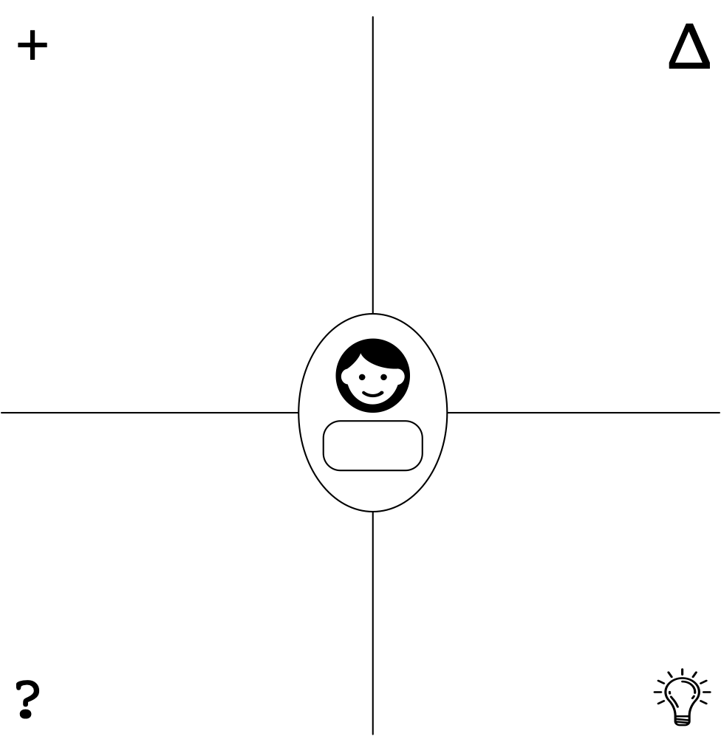
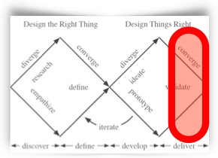

Prototype
1
Liked the availability of functions that we have, Very specific to common problems/questions that first year students may encounter Very accessible
The design of the website looked clean, (minimalistic, simple) making it easy to tell what does what
Doesn’t like that the menu is covering a large portion of the screen, should be able to hide the menu
Menu looks disorganized, try organizing menu
Some first year's may not know certain terms, adding descriptions would be helpful
Add a dark mode
When you hover over the point of the vector, show coordinates and maybe add description of the vector
Feedback Grid:
Use to take notes when getting feedback from individual users. Have one person do the talking, and a second take notes, but steer the conversation to cover all 4 areas.
first year who has taken linear algebra: Mason C.
When you're switching the value of the vector and you have your original vector and you have any of the transformations, when you swap the original vectors values, will the resultant vector change in real time?
Is there any way to manipulate the size of the matrix box? Ie. If you can make it change dimensions
Can you add more than 2 vectors? It's good to have multiple vectors so that you can save the vector and change its visibility
Will the grid have values?
If someone inputs a large vector, would the grid/axis scale? Or would it be too large for the screen?
+ | What did they like about it?
∆ | What would they like changed?
? | What questions did they ask?
 | What new ideas came out of the discussion?
Add a menu that can hide the menu
Add a dark mode
Add descriptions to each transformations
Add description to tip of vector when hovered over
5
https://www.svgrepo.com/svg/120932/light-bulb

Slide 34
Action Plan
What they said: | How we will improve:
Menu looked disorganized | Add sub menu's for different transformations
Menu took up too much room | Add a button to open and hide the menu
Some transformations may be confusing at first glance | Add descriptions and instructions for each transformation
This is for practice. Act on feedback from real users!

Slide 35
Questions for TA
If you have questions for TAs put them on a pink gradient background. If you prefer, you can add a black slide for raw interview notes, and summarize them on the empathy map. If you have two note-takers, you could use two text boxes.

Slide 36
Week 4 Feedback
Great work! 5/5 Jamie =)
By next week, you should get feedback from four potential users of your app.
This week you should clean up your slides (deleting extra slides you didn't use, add explanations for unusual things you did) because you will get 5% for the slides so far. You will get
2% for filling everything out (I.e., a reasonable number of boxes in each table, not necessarily every box)
1% for prototype originality and insight (subjective)
2% for copying the blue arrows to show trancability (e.g, how information from an interview led to a HMW statement) and explain the two examples here
This info
Led to this
This info
Led to this

Slide 37
Week 4 Feedback
2% for copying the blue arrows to show trancability (e.g, how information from an interview led to a HMW statement) and explain the two examples here​
This info
Led to this
This info
Led to this
When we were conducting the interviews, often, we heard the interviewees say that they struggled to comprehend vector transformations such as rotation and shear. They had to look at images and videos of these transformations in order to fully grasp the concept. Along with this, the TA that we interviewed also mentioned that the thing first years tend to struggle with is tying the calculations like inverse matrices or matrix multiplication to something physical that they can actually understand, and how it can be represented in the arithmetic. It was also mentioned that although software exists to solve these issues, there isn't a software that solves it all together (variety). Having said this, if first years were able to access some sort of software that would allow them to visualize various transformations, it would be easier for them to fully understand the concepts of transformations on vectors, instead of just comprehending it as random algebra applied to vectors. It would also be easier to visualize multiple transformations within the same piece of software
During the interviews, when we asked if they struggled to understand/comprehend vector transformations in 2 dimensions, they said that they did struggle, but were able to figure it out eventually because some 2 dimensional vectors can simply be drawn out on paper. However, when it came to 3 dimensions, it was much harder to visualize because it isn't something that can be easily drawn on a 2 dimensional surface. Due to this, when it came to vector transformations that occurred in dimensions greater than 3, we got the general idea that visualization became exponentially harder as the dimension increased. This led to our questions after the HMW process regarded a software that can handle 3 dimensions. When thinking about 3 dimensions, it is not as simple as simply moving x and y coordinates on the screen because the z coordinate will change the entire perspective of the vector, and thus change both the x and y coordinates. Thinking about this realistically, when we were writing our background labs, if there were many shapes, the elm IDE would begin to lag heavily every time it was compiled. Taking this into consideration along with time and our own coding capabilities, we were able to carefully think about the limits of our software, which is important because we did not want to prototype an app that is out of our reach given our current circumstances.

Slide 38
Prototype
1
Homescreen is pretty clear, has 3 buttons , indicating every function.
The red arrow obviously indicates the vector addition and multiplication, which is helpful for users to enter by clicking the button
The grid is good for focusing on the subject
It is great to select or diselect matrices to see the whole process
This info
Would better color the original/second vectors to differentiate.
Have a box for the matrix input would be better and clearer
It would better to add a scaling box below each vector
Would prefer the back button to be at the top left of the screen because of convention.
Feedback Grid:
Use to take notes when getting feedback from individual users. Have one person do the talking, and a second take notes, but steer the conversation to cover all 4 areas.
This info
+ | What did they like about it?
∆ | What would they like changed?
? | What questions did they ask?
 | What new ideas came out of the discussion?
Is the scalnig value only for the original vector or the second one or both?
Kevin Lao
Should make the user interface fancier, like adding pictures
Maybe add a feedback/ rate us button would help improve features
5
https://www.svgrepo.com/svg/120932/light-bulb

Slide 39
Prototype
1
Have a good choice of topics, convenient and useful for users.
Nice combination of multiple functions, so don't need to open some other app.
Although the Homescreen is pretty clear, it is still a bit too simple and monotonous as the main interface.
Only through the current version still not sure if some complex vector transformations can be visualized.
Feedback Grid:
Use to take notes when getting feedback from individual users. Have one person do the talking, and a second take notes, but steer the conversation to cover all 4 areas.
+ | What did they like about it?
∆ | What would they like changed?
? | What questions did they ask?
 | What new ideas came out of the discussion?
Is the vector transformation in the app only include 2D, or maybe will add the 3D in the future?
Can't wait to see the final product.
Can add a more elaborate background.
More features can be added.
5
https://www.svgrepo.com/svg/120932/light-bulb

Slide 40
Prototype
1
Home screen should be the graph view directly
Cheat sheet bar should be a little bar on top left
Vector addition, multiplication and transformation should be shown in one graph
Don't need to show vector operations all the time
Needs a menu that you can choose the transformation
Needs ability to directly modify the 2x2 transformation matrix
Needs rotation of the matrix
Needs dark mode
Ability to apply transformations on matrix
This info
This info
This info
Feedback Grid:
Use to take notes when getting feedback from individual users. Have one person do the talking, and a second take notes, but steer the conversation to cover all 4 areas.
+ | What did they like about it?
∆ | What would they like changed?
? | What questions did they ask?
 | What new ideas came out of the discussion?
Can users use keyboard to enter vectors?
Nick
Display the rotation of the matrix
Hide the functions tab when not needed
5
https://www.svgrepo.com/svg/120932/light-bulb

Slide 41
Pros and Cons
Prototype 1 | Prototype 2
Not simplified enough | N/A
Has great functionalities | N/A
May be hard to achieve | N/A
The app may be lagging | N/A
What did you learn from the two prototypes? Do you refine one or the other, synthesize them, or go in a new directions?

Slide 42
Action Plan
What they said: | How we will improve:
Needs a better interface | Adjust the background color, vector color and simplify the interface a little bit
Needs more functions | Add function that rotates the matrix. Add dark mode
N/A | N/A
Duplicate the Feedback and Action Plan slides for as many iterations as you can fit in.

Slide 43
Prototype
2
homescreen
Clicked this button
cheat sheet
to grid
instructions

Slide 44
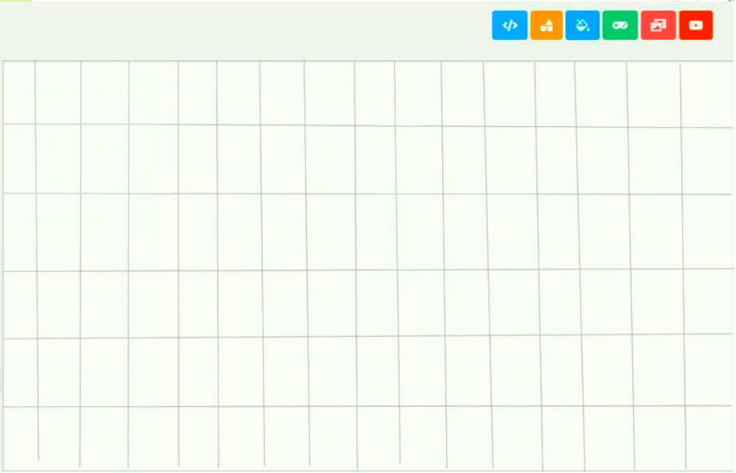
Prototype
2
Instructions
Grid
Cheat Sheet
vector addition + multiplication
vector transformations
clear
Clicked this button to open menu

Slide 45
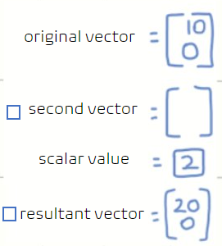
Prototype
2
Instructions
Grid
Cheat Sheet
vector addition + multiplication
vector transformations
clear
menu

Slide 46
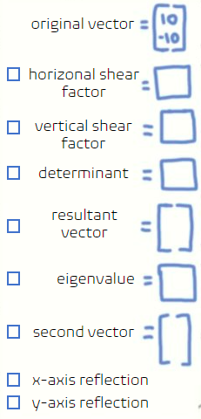
Prototype
2
Instructions
Grid
Cheat Sheet
vector addition + multiplication
vector transformations
clear
Click to open menu
Click again to close menu

Slide 47
Technical challenges
Challenge | What you will do: search resources, ask TAs for code example, build test program
Using sliders to control the values | Search for resources and ask TAs for further help and information
Hide the function tab when not being used | Try to build a module that can hide the tab. Ask TAs for help if encountering any problem.
Control the use of functions by checking the small box | Try to use buttons to realize that function, ask TAs for help if it doesn't work.

Slide 48
DT Slides Presentation 1
When you present your DT Slides to another group, you will mostly use the slides you have already made for your own purposes, but you should add in a slide summarizing what you have learned so far, and what your challenges will be for the rest of the project.
Goal: to help first year students taking linear algebra understand/comprehend the concepts further
Solution: creating a vector visualizer that displays how different transformations will affect a vector to further comprehension
Future challenges: Making the code concise enough for the elm GUI to handle it, and coding this is elm

Slide 49
Peer Feedback
What did audience question, where did explanations come out wrong, etc. | What will we do about it?
Show the calculation steps | Provide a button that will lead you to a new page which contains the calculation steps. You can go back by clicking the back button.
Make background colorful | Change the default color of the app background. Also adding a dark model.
N/A | N/A

Slide 50
Questions for TA
If you have questions for TAs put them on a pink gradient background. If you prefer, you can add a black slide for raw interview notes, and summarize them on the empathy map. If you have two note-takers, you could use two text boxes.
Can we get an example of the previous year's math visualizer project?

Slide 51
Week 5 Feedback
By next week, you should get feedback on your prototype from four potential users of your app.

Slide 52

Prototype
3
homescreen
user clicks here
instructions
to grid
cheat sheet

Slide 53

Prototype
3
grid
Highlighted to let the user know where they currently are
Led to this (menu bar)
Instructions
Grid
Cheat Sheet
Vector Addition + Multiplication
Vector Operations
clear
Scale for grid
calculations
User clicks here
Resets grid and vectors
Bring up a menu that shows detailed calculations about the current vector operations
(click grid button to go back to grid)

Slide 54


Prototype
3
grid
opened and highlighted menu
Instructions
Grid
Cheat Sheet
Vector Addition + Multiplication
Vector Operations
calculations
clear
original vector =
0
10
Click again to close menu
Checked off box
scalar value 1 =
second vector =
scalar value 2 =
resultant vector =
User can decide what is displayed on grid

Slide 55
Prototype
3
homescreen
Instructions
Grid
Cheat Sheet
Vector Addition + Multiplication
Vector Operations
calculations
clear
original vector =
Click to open menu
horizontal shear factor =
vertical shear factor =
determinant =
eigenvalue =
rotate vector =
x-axis reflection
y-axis reflection

Slide 56
DT Slides Presentation 1
When you present your DT Slides to another group, you will mostly use the slides you have already made for your own purposes, but you should add in a slide summarizing what you have learned so far, and what your challenges will be for the rest of the project.
Goal: to help first year students taking linear algebra understand/comprehend the concepts further
Solution: creating a vector visualizer that contains multiple vector operations and displays how they will affect a vector, to help further comprehension
Future challenges: working with the grid and being able to display vectors that are inputted accurately

Slide 57
Prototype
3
The background looks pretty good
The organization and layout of the content is clear, especially the ability to scale the grid size, as some of the app she used before was difficult to scale, so complicated
Like checked off box
This info
The color of vector after visualization
Add 3D vector calculations if that is possible
Feedback Grid:
Use to take notes when getting feedback from individual users. Have one person do the talking, and a second take notes, but steer the conversation to cover all 4 areas.
+ | What did they like about it?
∆ | What would they like changed?
? | What questions did they ask?
 | What new ideas came out of the discussion?
How many concepts will be on the cheat sheet?
Like checked off box, but would you use different colors for different vectors
Only perform calculations on at most two vectors?
Tina
The upper limit of vector calculation can be changed (for example, there can be up to 4 vector calculations)
5
https://www.svgrepo.com/svg/120932/light-bulb

Slide 58
Prototype
3
Pick a pretty good topic and can be a great help to study
Like the grid
The whole thing looks very clean
This info
Can change the background, the person being interviewed does not like this background very much
Can add more options if that is possible
Feedback Grid:
Use to take notes when getting feedback from individual users. Have one person do the talking, and a second take notes, but steer the conversation to cover all 4 areas.
+ | What did they like about it?
∆ | What would they like changed?
? | What questions did they ask?
 | What new ideas came out of the discussion?
How long did it take us to make this app, it looks amazing
Can’t wait to seeing the final results, can recommend more people to use
Hans
Can add several more backgrounds for different people to choose from
Besides the background, have no idea what else to be picky about
5
https://www.svgrepo.com/svg/120932/light-bulb

Slide 59
Action Plan
What they said: | How we will improve:
Need a larger amount of computation | Add more vector
Need a flexible background | Add more backgrounds for users to choose at will
N/A | N/A
Duplicate the Feedback and Action Plan slides for as many iterations as you can fit in.

Slide 60

Prototype
4
homescreen
instructions
to grid
cheat sheet
user clicks here

Slide 61
Prototype
4
homescreen
Option to change theme
instructions
to grid
cheat sheet

Slide 62
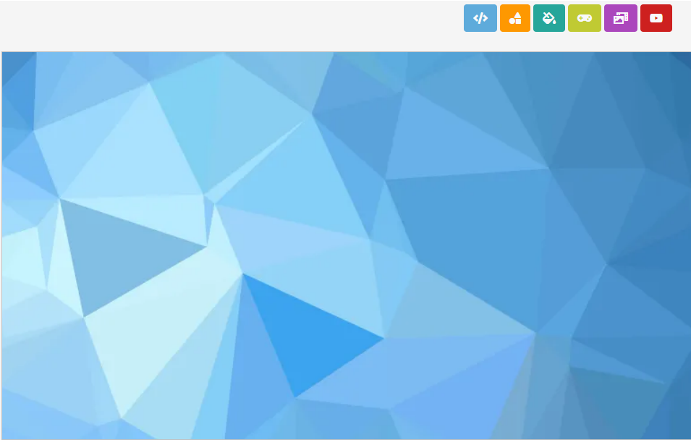
Prototype
4
homescreen
user clicks here
instructions
to grid
cheat sheet

Slide 63
Prototype
4
grid
Highlighted to let the user know where they currently are
Instructions
Grid
Cheat Sheet
Vector Addition + Multiplication
Vector Operations
clear
Scale for grid
calculations
User clicks here
Resets grid and vectors
Bring up a menu that shows detailed calculations about the current vector operations
(click grid button to go back to grid)

Slide 64
Prototype
4
grid
opened and highlighted menu
Instructions
Grid
Cheat Sheet
Vector Addition + Multiplication
Vector Operations
calculations
clear
original vector =
0
10
Click again to close menu
Checked off box
scalar value 1 =
second vector =
click to open menu and choose vector colour
scalar value 2 =
resultant vector =
User can decide what is displayed on grid
multiply vectors
add vectors together
create new vector
create a new vector to display

Slide 65
Prototype
4
homescreen
Instructions
Grid
Cheat Sheet
Vector Addition + Multiplication
Vector Operations
Click to open menu
calculations
clear
original vector =
Change vector colour
horizontal shear factor =
vertical shear factor =
determinant =
eigenvalue =
rotate vector =
x-axis reflection
y-axis reflection

Slide 66
Risks
Main things which could go wrong and prevent you from completing a working app. | What you can do about it? (assign a second person, find more users, etc.)
Because it is still only a prototype, so we have no idea if there will be some bugs during production. | - Do more tests - Find more users
Since we have grid scaling, it may be hard to scale the grid, while still maintaining the current visuals of the vectors | - test and play with grids to familiarize ourselves with the concept
There are many calculations involved in our app, so it may be difficult layering different operations on one vector and displaying it | - play around with vectors and see how order of transformations will affect the visuals of the vector

Slide 67
Questions for TA
If you have questions for TAs put them on a pink gradient background. If you prefer, you can add a black slide for raw interview notes, and summarize them on the empathy map. If you have two note-takers, you could use two text boxes.

Slide 68
Week 6 Feedback
By next week, you should get feedback on your prototype from four potential users of your app.

Slide 69
Prototype
4
Liked the aesthetic of the app overall and how clean and it appeared
Looked organized and easy on the eyes (not cluttered)
Easy to see what is accessible to the user from first glance
Add x and y axis on the grid
Outline axis to make it clear where the origin is
Grid scale is unclear, maybe add percentages of multiplier to make it more clear
To make the different vectors look different from each other, change design of vector
Feedback Grid:
Use to take notes when getting feedback from individual users. Have one person do the talking, and a second take notes, but steer the conversation to cover all 4 areas.
This info
+ | What did they like about it?
∆ | What would they like changed?
? | What questions did they ask?
 | What new ideas came out of the discussion?
What would be in the cheat sheet?
Would there be definitions available for beginner vector learners?
What would be in the instructions?
Change scale visuals
Highlight grid axis
Change vector designs
5
https://www.svgrepo.com/svg/120932/light-bulb

Slide 70
Prototype
4
Options to change the theme of the app so it appeals to a wide range of audiences
Option to reset grid to default
Calculation button to show all the steps
Need to click to a button to input values for the vector
Add more variety to vectors so they can be differentiated easily
Make vector operation menus smaller if possible
Change title screen to look more like an app (add name, title, logo)
Feedback Grid:
Use to take notes when getting feedback from individual users. Have one person do the talking, and a second take notes, but steer the conversation to cover all 4 areas.
+ | What did they like about it?
∆ | What would they like changed?
? | What questions did they ask?
 | What new ideas came out of the discussion?
When you change the colour of the vector, is it similar to the theme colours or is it a dynamic colour wheel the user can choose from
Is there a limit to the number of vectors you can have on the grid or can everything be on at once
When you switch tabs, do the current vector values inputted remain, or will they disappear?
Make vectors have more customization
Make vector operations menu more concise if possible
5
https://www.svgrepo.com/svg/120932/light-bulb

Slide 71
Action Plan
What they said: | How we will improve:
Different vectors need to be able to be differentiated easily | Allow the user to customize vectors more (shape, colour)
Make grid axis visible | Highlight the x and y axis
Duplicate the Feedback and Action Plan slides for as many iterations as you can fit in.

Slide 72
Prototype
5
homescreen
user clicks here
cheat sheet
instructions
to grid
and
key definitions
user clicks here

Slide 73
Prototype
5
homescreen
Option to change theme
cheat sheet
instructions
to grid
and
key definitions
Led to this

Slide 74
Prototype
5
homescreen
user clicks here
cheat sheet
instructions
to grid
and
key definitions

Slide 75
Prototype
5
grid
Highlighted to let the user know where they currently are
Instructions
Grid
Cheat Sheet
1x 1.5x 2x 2.5x 3x
Vector Addition + Multiplication
Vector Operations
clear
Scale for grid
calculations
User clicks here
Resets grid and vectors
Bring up a menu that shows detailed calculations about the current vector operations
(click grid button to go back to grid)
x
y

Slide 76
Prototype
5
grid
opened and highlighted menu
Instructions
Grid
Cheat Sheet
1x 1.5x 2x 2.5x 3x
Vector Addition + Multiplication
Vector Operations
calculations
clear
original vector =
0
10
Click again to close menu
Checked off box
scalar value 1 =
click to open menu and customize vector
second vector =
scalar value 2 =
resultant vector =
x
User can decide what is displayed on grid
multiply vectors
add vectors together
create new vector
create a new vector to display
y

Slide 77
Prototype
5
homescreen
Click to open menu
Instructions
Grid
Cheat Sheet
1x 1.5x 2x 2.5x 3x
Vector Addition + Multiplication
Vector Operations
Click to open and close menu
calculations
clear
original vector =
horizontal shear factor =
vertical shear factor =
Customize vector
determinant =
eigenvalue =
Also led to this
rotate vector =
x
x-axis reflection
y-axis reflection
y

Slide 78
DT Slides Presentation 1
Our goal is to help first year university students taking linear algebra fully grasp the concept of vectors and the operations that are associated with them.
Our solution is to create a vector visualizer app where the user will be able to perform vector operations on 2D vectors of their choice. The app will contain definitions and key formulas that the user can easily access to refresh/learn information regarding vector operations (eigenvalues, determinant etc.). It will also include detailed explanations on how the operations on the vectors were computed.
Through this experience, we have learned the importance of prototyping and getting feedback on these prototypes before the product itself is coded. By creating prototypes, we can flush out our ideas, and see what users would and wouldn't like. This helps to create new ideas for our app and also allows us to identify future issues and mitigate them before the final product is created.
A major future challenge for this app would be expanding it to allow 3D vectors. This would require a 3D vector space and would need much more computing/processing speed. With the current information we’ve learned as well as out current resources, it can be said that a 3D vector space would lag the GUI heavily, making the app unusable.

Slide 79
Peer Feedback
What did audience question, where did explanations come out wrong, etc. | What will we do about it?
Often times, when we presented our prototype, the audience/interviewees would ask about more details regarding our instruction/cheat sheet button | When presenting our prototype, we need to give more context and go into more detail regarding what we plan for our software to do, so that the user is not confused
Almost everyone we interviewed/presented to suggested that we expanded our horizons to cover 3D vectors | We will look into whether this is something we can complete/update our app to look like, however, at the moment, given our time and resources, we would not be able to create a usable app
Often times, the interviewee would say "I don't know what to change" when they needed to give feedback | Instead of being as direct, we can try to ease into a conversation with questions such as "if you were to use a vector visualizer, what would you like to see in the app?

Slide 80
Questions for TA
If you have questions for TAs put them on a pink gradient background. If you prefer, you can add a black slide for raw interview notes, and summarize them on the empathy map. If you have two note-takers, you could use two text boxes.

Slide 81
Week 7 Feedback
By next week, you should get feedback on your prototype from four potential users of your app.
This week you should clean up your slides (deleting extra slides you didn't use, add explanations for unusual things you did) because you will get 5% for the slides so far. You will get
2% for filling everything out (I.e., a reasonable number of boxes in each table, not necessarily every box)
1% for risk identification and mitigation strategy
2% for identifying something significant to improve based on practicing with peers (could be about project, DT slides or way you explain things or ask questions)
This info
Led to this
This info
Led to this

Slide 82
Week 7 Feedback
This info
Led to this
This info
Led to this
When we were conducting interviews, often times, the interviewee would say that they like the number of operations available to the user, however, accessing them was tedious and the menu took up too much of the screen due to the sheer number of operations. Of course, when designing an app, the interface is one of the most important components. Our first and second prototype had vector addition/multiplication and vector operations separated in two different screens, where you had to go back to the main screen in order to access one or the other. We realized that it didn't make sense to separate the two since they are both operations, so we decided to combine them into one screen. We also changed the interface to have a menu at the top of the screen so that the user can easily change from grid to cheat sheet etc. The user is also able to hide menu's when they are not in use so that they are not blocking the grid, and we were also able to keep our vast number of operations.
During the interviews, after we had explained our prototype and asked for feedback, a common thing that was said was "differentiating the different vectors" and being able to customize the app to the user's liking whether it be changing the way the vector looked or having a dark mode. In our first prototypes, there was no customization, though we had thought of the second vector being a different colour, it was not a colour that could be chosen by the user. After hearing this feedback consistently, we realized that it is important for our app to be able to satisfy and appeal to the different audiences our users may be in. This lead us to add customization to our vectors as well as our interface theme. The user is now able to change the colour of the background (though it is still limited to 6 colours..), and is able to change the colour of the vector (again, limited to 6 colours). However, they are also able to change the line type (dotted, dashed, or solid) of the vector to allow for further differentiation between multiple vectors.

Slide 83
Week 7 TA Feedback
Filling everything out: (2/2)
- Great work at filling things in the box. Time constraint is definitely one of the challenges every group is facing. Try to focus on getting the main function of your app to work and worry about the visual aspect after.
Risk identification and mitigation strategy: (1/1)
- Great work at identifying your risks and coming up with appropriate solutions.
Identifying something significant to improve: (2/2)
- Great work at taking peer feedback and applying them to your project.
Suggestion: if you are running out of feedback for your prototype, try getting your feedback from new users or try asking very specific questions about your prototype. i.e. Do you find _ function useful? If you were to do something, where would you click?
Nice job!
5/5
Jamie =)

Slide 84
Prototype
5
Pretty like the background, can choose the color you like.
Like the overall structure, very clean.
Think everything is good, don't know what else can be changed.
Feedback Grid:
Use to take notes when getting feedback from individual users. Have one person do the talking, and a second take notes, but steer the conversation to cover all 4 areas.
+ | What did they like about it?
∆ | What would they like changed?
? | What questions did they ask?
 | What new ideas came out of the discussion?
There doesn't seem to be enough grids to do a lot of vector computation.
Can make font size more uniform.(The size of "cheat sheet and key definitions" are difference from other words)
Looking forward to next week’s prototype, wondering what else can be add.
That will be better if we put an arrow on the x and y axis.
5
https://www.svgrepo.com/svg/120932/light-bulb

Slide 85
Prototype
5
Aesthetically pleasing as far as a math visualizer goes
Menu is convenient to navigate through, as well as knowing which tab you are currently in
Option to hide grid
Ability to drag vector using mouse cursor (will also auto update the vector values)
Ability to move vector position anywhere on the grid since vectors don’t relate to their position
Feedback Grid:
Use to take notes when getting feedback from individual users. Have one person do the talking, and a second take notes, but steer the conversation to cover all 4 areas.
+ | What did they like about it?
∆ | What would they like changed?
? | What questions did they ask?
 | What new ideas came out of the discussion?
Will the cheat sheet have definitions that are simple enough for a beginner to understand?
Will the scalar multiplier value be represented by a line?
Is there a dark mode available for the app?
Add ability to see skeleton of vector (x and y values)
5
https://www.svgrepo.com/svg/120932/light-bulb

Slide 86
Action Plan
What they said: | How we will improve:
Edit the axis to make it look like a typical axis | Add arrows to the end of the x and y axis
May be hard to see the x and y values of the vector without grid numbers | Add ability to see the skeleton (x and y) of the vector
Make vectors more user friendly | Ability to drag vector using cursor
Duplicate the Feedback and Action Plan slides for as many iterations as you can fit in.

Slide 87
Prototype
6
homescreen
cheat sheet
instructions
to grid
and
key definitions
user clicks here

Slide 88
Prototype
6
homescreen
Option to change theme
cheat sheet
instructions
to grid
and
key definitions

Slide 89
Prototype
6
homescreen
user clicks here
cheat sheet
instructions
to grid
and
key definitions

Slide 90
Prototype
6
grid
Highlighted to let the user know where they currently are
User clicks here
Instructions
Grid
Cheat Sheet
hide grid
1x 1.5x 2x 2.5x 3x
Vector Addition + Multiplication
Vector Operations
clear
Scale for grid
Hides all grid marks
calculations
Resets grid and vectors
Bring up a menu that shows detailed calculations about the current vector operations
(click grid button to go back to grid)
x
y

Slide 91
Prototype
6
grid
Instructions
Grid
Cheat Sheet
hide grid
1x 1.5x 2x 2.5x 3x
Vector Addition + Multiplication
Vector Operations
calculations
clear
User clicks here
x
y

Slide 92

Prototype
6
grid
opened and highlighted menu
Instructions
Grid
Cheat Sheet
1x 1.5x 2x 2.5x 3x
Vector Addition + Multiplication
Vector Operations
calculations
clear
original vector =
0
10
Click again to close menu
Checked off box
scalar value 1 =
second vector =
scalar value 2 =
User's cursor can be used to drag vector
x
resultant vector =
User can decide what is displayed on grid
multiply vectors
add vectors together
create new vector
create a new vector to display
y

Slide 93
Prototype
6
grid
Instructions
Grid
Cheat Sheet
1x 1.5x 2x 2.5x 3x
Vector Addition + Multiplication
Vector Operations
calculations
clear
original vector =
10
10
Vector size will immediately refresh based on where the user drags the vector
scalar value 1 =
click to open menu and customize vector
second vector =
scalar value 2 =
User drags vector
resultant vector =
x
multiply vectors
add vectors together
create new vector
y

Slide 94
Prototype
6
grid
opened and highlighted menu
Instructions
Grid
Cheat Sheet
1x 1.5x 2x 2.5x 3x
Vector Addition + Multiplication
Vector Operations
calculations
clear
original vector =
10
10
Click again to close menu
Checked off box
scalar value 1 =
second vector =
scalar value 2 =
10
resultant vector =
x
show skeleton
10
User can decide what is displayed on grid
multiply vectors
add vectors together
shows x and y components of vector
create new vector
create a new vector to display
y

Slide 95
Prototype
6
homescreen
Click to open menu
Instructions
Grid
Cheat Sheet
1x 1.5x 2x 2.5x 3x
Vector Addition + Multiplication
Vector Operations
Click to open and close menu
calculations
clear
original vector =
horizontal shear factor =
vertical shear factor =
Customize vector menu
determinant =
eigenvalue =
rotate vector =
x
x-axis reflection
y-axis reflection
y

Slide 96
Questions for TA
If you have questions for TAs put them on a pink gradient background. If you prefer, you can add a black slide for raw interview notes, and summarize them on the empathy map. If you have two note-takers, you could use two text boxes.

Slide 97
Week 8 Feedback
By next week, you should get feedback on your prototype from four potential users of your app.

Slide 98
Prototype
6
Like the layout because they are easy for users to find and instructions are informative.
Being able to drag the vector and automatically change
Being able to change the color for better differentiation.
Like close/open the grid
Would change the first letter to capital for clearer vision aesthetically
Expect to see the cheat sheet/ key definition prototypes look like
Feedback Grid:
Use to take notes when getting feedback from individual users. Have one person do the talking, and a second take notes, but steer the conversation to cover all 4 areas.
+ | What did they like about it?
∆ | What would they like changed?
? | What questions did they ask?
 | What new ideas came out of the discussion?
Does menu bar disappear when one vector going to the top left direction or they will overlap each other?
Will the red arrows with instructions come up in the real math visualizer?
What does cheat sheet contain and why does it help to practice the visualizer?
How many vectors can it handle at once?
Nadia
Add projection onto the vector addition
Would be more functional to make determinants in higher dimensions with calculations.
Being able to close/open axis
Adding values on the axis
5
https://www.svgrepo.com/svg/120932/light-bulb

Slide 99
Prototype
6
Like being able to drag the vector without inputting values
Changing colors and making lines solid/dashed/makes It easier to distinguish different vectors
It is great and powerful to do the vector operation calculations by inputting numbers.
The calculation function is useful to show the user each detailed step of calculation.
It's not necessary to add the scalar value since it's already convenient to drag or modify the vector through operations
Would change the rotate thing from a box to a list of options, like rotate through the origin, rotate 45 degrees clockwise, rotate about the x-axis...
Feedback Grid:
Use to take notes when getting feedback from individual users. Have one person do the talking, and a second take notes, but steer the conversation to cover all 4 areas.
+ | What did they like about it?
∆ | What would they like changed?
? | What questions did they ask?
 | What new ideas came out of the discussion?
Do the axis contain numebers?
What does the scalar do?
Can this visualizer handle more than 3 vectors?
Why have a function to clear/open grids?
Can u drag the point not only from the point that the arrow points to, and also from the origin?
Will the eigenvalue box show more than one result since it has only one box?
What does instructions button actually do?
What is in the cheatsheet?
Fan
Create numbers along the axis to make it clear
Can actually scale down the grid rather than just scaling up
5
https://www.svgrepo.com/svg/120932/light-bulb

Slide 100
Action Plan
What they said: | How we will improve:
It would be more helpful for the user to add numbers along both axis | Add numbers on axis
It would be helpful to add more scaling buttons | Add scaling down buttons
Would be more functional to make determinants in higher dimensions with calculations. | Make the determinants' calculations in more dimensions
Duplicate the Feedback and Action Plan slides for as many iterations as you can fit in.

Slide 101
Prototype
7
homescreen
cheat sheet
instructions
to grid
and
key definitions
user clicks here

Slide 102
Prototype
7
homescreen
Option to change theme
cheat sheet
instructions
to grid
and
key definitions

Slide 103
Prototype
7
homescreen
user clicks here
cheat sheet
instructions
to grid
and
key definitions

Slide 104
Prototype
7
grid
Highlighted to let the user know where they currently are
User clicks here
Instructions
Grid
Cheat Sheet
hide axis
hide grid
0.2x 0.5x 1x 1.5x 2x
Vector Addition + Multiplication
Vector Operations
40
30
20
10
0
-10
-20
-30
-40
Hides axis
Scale for grid
calculations
clear
Hides all grid marks
Resets grid and vectors
Bring up a menu that shows detailed calculations about the current vector operations
(click grid button to go back to grid)
-70 -60 -50 -40 -30 -20 -10 10 20 30 40 50 60 70
x
y

Slide 105
Prototype
7
grid
Instructions
Grid
Cheat Sheet
hide axis
hide grid
0.2x 0.5x 1x 1.5x 2x
Vector Addition + Multiplication
Vector Operations
calculations
clear
User clicks here
x
y

Slide 106
Prototype
7
grid
opened and highlighted menu
Instructions
Grid
Cheat Sheet
hide axis
hide grid
0.2x 0.5x 1x 1.5x 2x
Vector Addition + Multiplication
Vector Operations
40
30
20
10
-10
-20
-30
-40
calculations
clear
original vector =
0
10
Click again to close menu
Checked off box
scalar value 1 =
second vector =
scalar value 2 =
User's cursor can be used to drag vector
-30 -20 -10 10 50 60 70
resultant vector =
x
User can decide what is displayed on grid
multiply vectors
add vectors together
create new vector
create a new vector to display
y

Slide 107
Prototype
7
grid
Instructions
Grid
Cheat Sheet
hide axis
hide grid
0.2x 0.5x 1x 1.5x 2x
Vector Addition + Multiplication
Vector Operations
40
20
10
-10
-20
-30
-40
calculations
clear
original vector =
10
10
Vector size will immediately refresh based on where the user drags the vector
scalar value 1 =
click to open menu and customize vector
second vector =
scalar value 2 =
User drags vector
-30 -20 -10 10 20 50 60 70
resultant vector =
x
multiply vectors
add vectors together
create new vector
y

Slide 108
Prototype
7
grid
opened and highlighted menu
Instructions
Grid
Cheat Sheet
hide axis
hide grid
0.2x 0.5x 1x 1.5x 2x
Vector Addition + Multiplication
Vector Operations
40
30
20
10
-20
-30
-40
calculations
clear
original vector =
10
10
Click again to close menu
Checked off box
scalar value 1 =
second vector =
scalar value 2 =
10
-10 20 30 40 50 60 70
resultant vector =
show skeleton
x
10
User can decide what is displayed on grid
multiply vectors
add vectors together
shows x and y components of vector
create new vector
create a new vector to display
y

Slide 109
Prototype
7
homescreen
Click to open menu
Instructions
Grid
Cheat Sheet
hide axis
hide grid
0.2x 0.5x 1x 1.5x 2x
Vector Addition + Multiplication
Vector Operations
40
10
0
-10
-20
-30
-40
Click to open and close menu
calculations
clear
original vector =
horizontal shear factor =
vertical shear factor =
Customize vector menu
determinant =
eigenvalue =
-70 -60 -50 -40 10 20 30 40 50 60 70
rotate vector
x
x-axis reflection
y-axis reflection
y

Slide 110
Prototype
7
homescreen
Instructions
Grid
Cheat Sheet
hide axis
hide grid
0.2x 0.5x 1x 1.5x 2x
Vector Addition + Multiplication
Vector Operations
40
30
20
10
-20
-30
-40
calculations
clear
original vector =
horizontal shear factor =
vertical shear factor =
Rotate vector by preset values or enter your own values
determinant =
eigenvalue =
-70 -60 -50 -40 20 30 40 50 60 70
rotate vector
45 degrees
x
x-axis reflection
90 degrees
y-axis reflection
180 degrees
Enter Degrees
y

Slide 111
Prototype
7
homescreen
user clicks here
cheat sheet
instructions
to grid
and
key definitions

Slide 112
Prototype
7
The most common definitions
1. Vector multiplication :
Vector multiplication refers to one of several techniques for the multiplication of two (or more) vectors with themselves
2. Vector addition
Vector addition is the operation of adding two or more vectors together into a vector sum.
3. Dot product:
Dot product is the sum of the products of the corresponding entries of the two sequences of numbers.
4. Cross product:
The cross product × : R3 ×R3 → R3 is an operation that takes two vectors u and v in space and determines another vector u×v in space.

Slide 113
Prototype
7
5. Determinant:
Determinant in linear and multilinear algebra, a value, denoted det A, associated with a square matrix A of n rows and n columns
6. Eigenvalues:
Eigenvalues are a special set of scalars associated with a linear system of equations (i.e., a matrix equation)
7. Subtraction:
Subtraction of matrix is possible by subtracting the element of another matrix if they have the same order.
8. Inverse:
Inverse are pairs of mathematical manipulations in which one operation undoes the action of the other text

Slide 114
Questions for TA
If you have questions for TAs put them on a pink gradient background. If you prefer, you can add a black slide for raw interview notes, and summarize them on the empathy map. If you have two note-takers, you could use two text boxes.

Slide 115
Week 9 Feedback
By next week, you should get feedback on your prototype from four potential users of your app.

Slide 116
Prototype
7
The overall structure is simple and clear.
Know how to use it at first sight, no extra instruction required
Like the clear button, not like some of the apps he used before.
Like the existence of cheat sheets.
Can also change the background color of the grid.
Feels that the precision of the drag function is not very high if you want a small number
Feedback Grid:
Use to take notes when getting feedback from individual users. Have one person do the talking, and a second take notes, but steer the conversation to cover all 4 areas.
+ | What did they like about it?
∆ | What would they like changed?
? | What questions did they ask?
 | What new ideas came out of the discussion?
Wanna know what's the instruction page looks like.
Wondering if the final calculated answer will show up on the graph.
Want to know what is the upper limit for creating new vectors.
hans
But still hope to add example in the cheat sheet section, because that can make it easier to understand the concept.
!!! Add instruction page !!!
5
https://www.svgrepo.com/svg/120932/light-bulb

Slide 117
Prototype
7
Scaling of the grid is fairly accurate
Color themes and customization are put into proper toggle menus that are consistent
Ability to change vector dimensions by dragging is very convenient
Rotation of vectors has many options available for the user
The cheat sheet could have visual components to make it easier for the user to comprehend
Feedback Grid:
Use to take notes when getting feedback from individual users. Have one person do the talking, and a second take notes, but steer the conversation to cover all 4 areas.
+ | What did they like about it?
∆ | What would they like changed?
? | What questions did they ask?
 | What new ideas came out of the discussion?
Will there be a way the user can set their own axis scale?
how will new vectors be shown on the menu?
Add more visuals to the calculation screen, cheat sheet, and definition screen
Ensure that screens/menu designs are uniform
Add grid settings to allow more customization
5
https://www.svgrepo.com/svg/120932/light-bulb

Slide 118
Action Plan
What they said: | How we will improve:
Have no idea what's the instruction page looks like. | Add prototype of instruction page
Add more grid customization | Add button to adjust grid settings (axis scale, grid background colour)
Cheat sheet is harder to comprehend without examples | Add examples and images of calculations to cheat sheet
Duplicate the Feedback and Action Plan slides for as many iterations as you can fit in.

Slide 119
Prototype
8
homescreen
cheat sheet
instructions
to grid
and
key definitions
user clicks here

Slide 120
Prototype
8
homescreen
Option to change theme
cheat sheet
instructions
to grid
and
key definitions

Slide 121
Prototype
8
homescreen
user clicks here
cheat sheet
instructions
to grid
and
key definitions

Slide 122
Prototype
8
instructions
Instructions
Grid
Cheat Sheet
pg 1/2
Common definitions
user clicks here to access example of definition
use arrows to navigate through pages
1. Vector multiplication :
Vector multiplication refers to one of several techniques for the multiplication of two (or more) vectors with themselves
example
2. Vector addition
Vector addition is the operation of adding two or more vectors together into a vector sum.
example
3. Dot product:
Dot product is the sum of the products of the corresponding entries of the two sequences of numbers.
example
4. Cross product:
The cross product × : R3 ×R3 → R3 is an operation that takes two vectors u and v in space and determines another vector u×v in space.
example
5. Determinant:
Determinant in linear and multilinear algebra, a value, denoted det A, associated with a square matrix A of n rows and n columns
example

Slide 123

Prototype
8
instructions
Instructions
Grid
Cheat Sheet
Vector Addition
back
Vector addition
Vector addition is the operation of adding two or more vectors together into a vector sum.
1
2
3
4
Let vector A = and vector B = . Then,
A + B = + =
1
2
3
4
4
6
Vector A + Vector B = Vector A + B

Slide 124
Prototype
8
instructions
Instructions
Grid
Cheat Sheet
pg 2/2
Common definitions
6. Eigenvalues:
Eigenvalues are a special set of scalars associated with a linear system of equations (i.e., a matrix equation)
example
7. Subtraction:
Subtraction of matrix is possible by subtracting the element of another matrix if they have the same order.
example
8. Inverse:
Inverse are pairs of mathematical manipulations in which one operation undoes the action of the other text
example

Slide 125
Prototype
8
homescreen
user clicks here
cheat sheet
instructions
to grid
and
key definitions

Slide 126
Prototype
8
grid
Highlighted to let the user know where they currently are
User clicks here
Instructions
Grid
Cheat Sheet
hide axis
hide grid
0.2x 0.5x 1x 1.5x 2x
Vector Addition + Multiplication
Vector Operations
40
30
20
10
0
-10
-20
-30
-40
Scale for grid
calculations
clear
Hides axis
Hides all grid marks
Resets grid and vectors
Bring up a menu that shows detailed calculations about the current vector operations
(click grid button to go back to grid)
-70 -60 -50 -40 -30 -20 -10 10 20 30 40 50 60 70
x
y

Slide 127
Prototype
8
grid
opened and highlighted menu
Instructions
Grid
Cheat Sheet
hide axis
hide grid
0.2x 0.5x 1x 1.5x 2x
Vector Addition + Multiplication
Vector Operations
40
30
20
10
-10
-20
-30
-40
calculations
clear
original vector =
0
10
Click again to close menu
Checked off box
scalar value 1 =
second vector =
scalar value 2 =
User's cursor can be used to drag vector
-30 -20 -10 10 50 60 70
resultant vector =
x
User can decide what is displayed on grid
multiply vectors
add vectors together
create new vector
create a new vector to display
y

Slide 128
Prototype
8
grid
Instructions
Grid
Cheat Sheet
hide axis
hide grid
0.2x 0.5x 1x 1.5x 2x
Vector Addition + Multiplication
Vector Operations
40
20
10
-10
-20
-30
-40
calculations
clear
original vector =
10
10
Vector size will immediately refresh based on where the user drags the vector
scalar value 1 =
click to open menu and customize vector
second vector =
scalar value 2 =
User drags vector
-30 -20 -10 10 20 50 60 70
resultant vector =
x
multiply vectors
add vectors together
create new vector
y

Slide 129
Prototype
8
grid
opened and highlighted menu
Instructions
Grid
Cheat Sheet
hide axis
hide grid
0.2x 0.5x 1x 1.5x 2x
Vector Addition + Multiplication
Vector Operations
40
30
20
10
-20
-30
-40
calculations
clear
original vector =
10
10
Click again to close menu
Checked off box
scalar value 1 =
second vector =
scalar value 2 =
10
-10 20 30 40 50 60 70
resultant vector =
show skeleton
x
10
User can decide what is displayed on grid
multiply vectors
add vectors together
shows x and y components of vector
create new vector
create a new vector to display
y

Slide 130
Prototype
8
homescreen
Click to open menu
Instructions
Grid
Cheat Sheet
hide axis
hide grid
0.2x 0.5x 1x 1.5x 2x
Vector Addition + Multiplication
Vector Operations
40
10
0
-10
-20
-30
-40
Click to open and close menu
calculations
clear
original vector =
horizontal shear factor =
vertical shear factor =
Customize vector menu
determinant =
eigenvalue =
-70 -60 -50 -40 10 20 30 40 50 60 70
rotate vector
x
x-axis reflection
y-axis reflection
y

Slide 131
Prototype
8
homescreen
Instructions
Grid
Cheat Sheet
hide axis
hide grid
0.2x 0.5x 1x 1.5x 2x
Vector Addition + Multiplication
Vector Operations
40
30
20
10
-20
-30
-40
calculations
clear
original vector =
horizontal shear factor =
vertical shear factor =
Rotate vector by preset values or enter your own values
determinant =
eigenvalue =
-70 -60 -50 -40 20 30 40 50 60 70
rotate vector
45 degrees
x
x-axis reflection
90 degrees
y-axis reflection
180 degrees
Enter Degrees
y

Slide 132
Prototype
8
homescreen
user clicks here
cheat sheet
instructions
to grid
and
key definitions

Slide 133

Prototype
8
instructions
Instructions
Grid
Cheat Sheet
pg 1/3
Provide the user with a choice of two functions
cheat sheet
to grid
and
key definitions

Slide 134
Prototype
8
instructions
Instructions
Grid
Cheat Sheet
pg 2/3
If the user choose "to grid"
cheat sheet
to grid
and
key definitions

Slide 135
Prototype
8
grid
Highlighted to let the user know where they currently are
User clicks here
Instructions
Grid
Cheat Sheet
0.2x 0.5x 1x 1.5x 2x
(pg 2)
hide axis
hide grid
Vector Addition + Multiplication
Vector Operations
40
30
20
10
0
-10
-20
-30
-40
Hides axis
Scale for grid
calculations
clear
Hides all grid marks
Resets grid and vectors
Bring up a menu that shows detailed calculations about the current vector operations
(click grid button to go back to grid)
-70 -60 -50 -40 -30 -20 -10 10 20 30 40 50 60 70
x
y

Slide 136
Prototype
8
grid
opened and highlighted menu
Instructions
Grid
Cheat Sheet
hide axis
hide grid
0.2x 0.5x 1x 1.5x 2x
Vector Addition + Multiplication
Vector Operations
40
30
20
10
-10
-20
-30
-40
(pg 2)
calculations
clear
original vector =
0
10
Click again to close menu
Checked off box
scalar value 1 =
second vector =
scalar value 2 =
User's cursor can be used to drag vector
-30 -20 -10 10 50 60 70
resultant vector =
x
User can decide what is displayed on grid
multiply vectors
add vectors together
create new vector
create a new vector to display
y

Slide 137
Prototype
8
grid
Instructions
Grid
Cheat Sheet
hide axis
hide grid
0.2x 0.5x 1x 1.5x 2x
Vector Addition + Multiplication
Vector Operations
40
30
20
10
-20
-30
-40
(pg 2)
calculations
clear
original vector =
horizontal shear factor =
vertical shear factor =
Rotate vector by preset values or enter your own values
determinant =
eigenvalue =
-70 -60 -50 -40 20 30 40 50 60 70
rotate vector
45 degrees
x
x-axis reflection
90 degrees
y-axis reflection
180 degrees
Enter Degrees
y

Slide 138
Prototype
8
instructions
Instructions
Grid
Cheat Sheet
pg 3/3
If the user choose "cheat sheet and key definitions"
cheat sheet
to grid
and
key definitions

Slide 139
Prototype
8
instructions
Instructions
Grid
Cheat Sheet
The most common definitions​
(pg 3)
1. Vector multiplication : …......​
6. Eigenvalues: ​…......​
2. Vector addition: …......​
7. Subtraction: …......​
3. Dot product: …......
8. Inverse: ​…......​
4. Cross product: …......​
5. Determinant: ​…......​

Slide 140
Questions for TA
If you have questions for TAs put them on a pink gradient background. If you prefer, you can add a black slide for raw interview notes, and summarize them on the empathy map. If you have two note-takers, you could use two text boxes.

Slide 141
Week 10 Feedback
Fasten seatbelts for final presentations.
This week you should clean up your slides (deleting extra slides you didn't use, add explanations for unusual things you did) because you will get 10% for the slides so far.
3% (tasks: 3% if all tasks are recorded with assignment and completion; 2% if most tasks are recorded completely, 1% if many records are missing, or the number of records is not sufficient)
3% (action plans: 3% if what the user said/did and what you will do about it are always clear and the next prototype follows up on that, 0%-2% based on how often the action plans are clear and followed up on)
3% (real problem: 3% if the prototype is clearly solving a problem identified by the user, 2% if there is a real, clear problem but it is not clearly solved, 1% if the problem is vague, and not clearly satisfied, 0% if there is no problem)
1% overall presentation
Great work!
10/10
Jamie =)

Slide 142
Pitch Component

Slide 143
Linear Algebra 2D Vector Visualizer
Andy Luo, Corinna Lin, Zhanxu Ye, Haoxuan Huang, Wentao Sun

Slide 144

Meet Bob Daniel!

Slide 145
Bob Daniel
First year university student
Is a visual learner
Understands vector operations theoretically, but struggles to apply them
Often forgets important concepts when completing assignments

Slide 146
Who we are
Developers: first-year university who have taken linear algebra
Experienced our own difficulties in the course
Use our knowledge to develop a product that can help other students
Aid their understanding of 2D vector operations

Slide 147
Our Solution
Hard to grasp that transformations are not only theoretical, but are also applicable
Made it hard to comprehend transformations in higher dimensions
Being able to visually see how transformations physically affect vectors, will allow for a better understanding of how transformations

Slide 148
2D Vector Visualizer
cheat sheet
instructions
to grid
and
key definitions

Slide 149
2D Vector Visualizer
cheat sheet
instructions
to grid
and
key definitions

Slide 150
homescreen
2D Vector Visualizer
cheat sheet
instructions
to grid
and
key definitions

Slide 151
homescreen
2D Vector Visualizer
cheat sheet
instructions
to grid
and
key definitions

Slide 152
Instructions
Grid
Cheat Sheet
pg 1/2
Common definitions
1. Vector multiplication :
Vector multiplication refers to one of several techniques for the multiplication of two (or more) vectors with themselves
example
2. Vector addition
Vector addition is the operation of adding two or more vectors together into a vector sum.
example
3. Dot product:
Dot product is the sum of the products of the corresponding entries of the two sequences of numbers.
example
4. Cross product:
The cross product × : R3 ×R3 → R3 is an operation that takes two vectors u and v in space and determines another vector u×v in space.
example
5. Determinant:
Determinant in linear and multilinear algebra, a value, denoted det A, associated with a square matrix A of n rows and n columns
example

Slide 153
Instructions
Grid
Cheat Sheet
Vector Addition
back
Vector addition
Vector addition is the operation of adding two or more vectors together into a vector sum.
1
2
3
4
Let vector A = and vector B = . Then,
A + B = + =
1
2
3
4
4
6
Vector A + Vector B = Vector A + B

Slide 154
Instructions
Grid
Cheat Sheet
pg 1/2
Common definitions
1. Vector multiplication :
Vector multiplication refers to one of several techniques for the multiplication of two (or more) vectors with themselves
example
2. Vector addition
Vector addition is the operation of adding two or more vectors together into a vector sum.
example
3. Dot product:
Dot product is the sum of the products of the corresponding entries of the two sequences of numbers.
example
4. Cross product:
The cross product × : R3 ×R3 → R3 is an operation that takes two vectors u and v in space and determines another vector u×v in space.
example
5. Determinant:
Determinant in linear and multilinear algebra, a value, denoted det A, associated with a square matrix A of n rows and n columns
example

Slide 155
Instructions
Grid
Cheat Sheet
hide axis
hide grid
0.2x 0.5x 1x 1.5x 2x
Vector Addition + Multiplication
Vector Operations
40
30
20
10
0
-10
-20
-30
-40
calculations
clear
-70 -60 -50 -40 -30 -20 -10 10 20 30 40 50 60 70
x
y

Slide 156
Instructions
Grid
Cheat Sheet
hide axis
hide grid
0.2x 0.5x 1x 1.5x 2x
Vector Addition + Multiplication
Vector Operations
40
30
20
10
0
-10
-20
-30
-40
calculations
clear
-70 -60 -50 -40 -30 -20 -10 10 20 30 40 50 60 70
x
y

Slide 157
Instructions
Grid
Cheat Sheet
hide axis
hide grid
0.2x 0.5x 1x 1.5x 2x
Vector Addition + Multiplication
Vector Operations
40
30
20
10
-20
-30
-40
calculations
clear
original vector =
10
10
axis scale =
scalar value 1 =
second vector =
scalar value 2 =
10
-10 20 30 40 50 60 70
resultant vector =
show skeleton
x
10
multiply vectors
add vectors together
create new vector
y

Slide 158
Allow the user to understand concepts theoretically and physically

Slide 159
Design Thinking Process
Empathize
1
Define
2
Ideate
3
Validate
5
Prototype
4

Slide 160
Emphasize
Interviewed students (first year) and linear algebra TA
We, the developers, had a general idea of what difficulties arise
By interviewing more people, we were able to create a general problem
Gained new perspectives

Slide 161
- Shear or inflection of the matrix is hard to imagine - transposing is simple because you're just flipping things in the matrix - hard to learn the inverse of a matrix, especially when it comes to visualizing it
Things they would like in a vector transformation app: - some kind of transformation where you are able to change the vector and see the entire grid - the ability to chain the transformations together and show the final transformation/final vector if you were a ta, and you were teaching transformations would it help to visually show it? - yes it would help because it emphasizes the idea that transformations have a visual component to them and are not just a random multiplication that are applied to vectors - eigenvector and eigenvalues with visuals are much more easy to understand
Seems interested in how to graph vector transformations, wants to know more about how we plan to do it (which makes sense because they're interested in computer graphics)
Make a dark mode for the grid
When he heard its going to written in elm, he said it makes it 10x harder (as compared to a language such as python)
Took him a while to answer when we asked him if he could visualize the span of a matrix (confusion)
Finding the determinant of a 2x2 matrix is simply calculating the area of the parallelogram
Nick.T (first year student)
Enjoy watching youtuber 3blue 1 brown showing visually how the vector transformation is done to help understanding
Coordinate systems would be difficult to understand for a beginner because converting from one vector to another is difficult because you need to take the inverse, which he thought was counterintuitive
Visualizing transformations would help to further understand the concept because seeing a visual representation of what's going on allows you to understand it visually and will make it easier to remember and recognize the transformation next time it is seen, making transformations more intuitive, memorable and applicable
Hard to compute vector transformation by hand.

Slide 162
1B03 was the first time he taught linear algebra last semester
Any time you can provide a visual representation such as graphs or pictures to enhance learning by providing visuals is a good idea
main thing that first years tend to struggle with is taking the vector transformations they are learning and tying them to something physical that they can actually understand, such as moving an object on a table and how that can be represented in the arithmetic - first year linear algebra course does not
main problem is that some of the intuitions you get about how transformations work are special in 2 or 3 dimensions and don’t generalize higher dimensions - ex: cross product is specific to 3D vectors
thing that is the most useful and hardest to make is something where you can draw vectors in 3D because you need to be able to drag and manipulate the space
people don’t tend to dislike/like topics but it boils down to whether they find them easy or hard to understand
visualization apps are less helpful when working in abstract math as it takes time to build intuition
given a set of vectors, you need to have a friendly user interface that tells you interesting things about those vectors
By the end of the course, first year students may feel like they learned something that doesn't relate to something they care about
Linear Algebra TA: Fletcher Gates
main problem with freely available linear algebra tools is that everything is out there but are not combined into a single app (annoying to have to use multiple different software's for different transformations)
When providing visuals, it is important to make sure that the visuals are not misleading to prove intuition
Something that caused the most confusion were the abstract vector space questions
First year linear algebra course does not develop the understanding/connection between arithmetic on vectors and how it actually affects the vector visually/physically
provide a set of vectors in R3 and provide as much useful information about them - ex: volume of a parallelepiped is a group of vectors linearly dependent/independent; if dependent, provide an example of where they are linearly dependent where they add to 0, if you were to use a set of independent vectors, provide a change of basis matrix
1

Slide 163
Define
gather all the problems discovered, specify the goal of our product to be
trying to solve multiple problems will cause a project to be lackluster and messy
1 | Crazy idea
2 | Hard to understand b-coordinates without visualizing it.
3 | Hard to understand and visualize the effect of matrix transformations
4 | Hard to visualize span
5 | Hard to memorize the matrices for different important transformations (e.g. sheer, inflection, etc,) without visuals
6 | Hard to understand and visualize eigen vectors and eigen values without visuals.
7 | Hard to visualize the composition between multiple different transformations,
8 | Some visualization apps don't have dark mode for those late night 5am study sessions
9 | Hand computation is tedious.
10 | Hard to visualize and understand the inverse of matrices.
11 | Hard to understand that vector addition and scalar multiplication isn't just random computation and that they have actual visual effects attributed to them(I.e.

Slide 164
Ideate
Brainstormed ways to create our solution
Forces you to realize limits and capabilities
When considering resources and capabilities, we would be able to create a functional prototype using 2D vectors
2​ | Create a GUI that can display vectors and their effects after various vector transformations in order to further understanding and comprehension​
3​ | Calculate inverses of matrices, and display it visually​
4​ | Create cheat sheet that includes vector transformations (descriptions and formulas to go along with each definition)​
5​ | Create a vector visualizer that has a dark mode​
6​ | Add a calculator to program so that user does not need to do any hand computations​

Slide 165
Prototype
Design prototypes and receive feedback to create more prototypes
constantly able to improve our product and modify it so that it would better fit the user’s needs

Slide 166
Prototype
1
Vector addition and multiplication screen
original vector
back
second vector
scalar value
resultant vector

Slide 167
Prototype
1
Vector transformation screen
original vector
original vector
back
back
back
horizonal shear factor
horizonal shear factor
vertical shear factor
vertical shear factor
determinant
determinant
resultant vector
eigenvector
eigenvalue
second vector
x-axis reflection
y-axis reflection

Slide 168
Prototype
1
Vector transformation screen
original vector
original vector
back
back
back
horizonal shear factor
horizonal shear factor
vertical shear factor
vertical shear factor
determinant
determinant
resultant vector
eigenvector
eigenvalue
second vector
x-axis reflection
y-axis reflection

Slide 169

Prototype
8
Instructions
Grid
Cheat Sheet
hide axis
hide grid
0.2x 0.5x 1x 1.5x 2x
Vector Addition + Multiplication
Vector Operations
40
30
20
10
-10
-20
-30
-40
calculations
clear
original vector =
0
10
scalar value 1 =
second vector =
scalar value 2 =
-30 -20 -10 10 20 30 40 50 60 70
resultant vector =
x
multiply vectors
add vectors together
create new vector
y

Slide 170
Feedback Before Feedback After
Home screen should be the graph view directly​
Cheat sheet bar should be a little bar on top left​
Vector addition, multiplication and transformation should be shown in one graph​
Don't need to show vector operations all the time​
Needs a menu that you can choose the transformation​
Needs ability to directly modify the 2x2 transformation matrix​
Needs rotation of the matrix​
Needs dark mode​
The overall structure is simple and clear.​
Know how to use it at first sight, no extra instruction required​
Like the clear button, not like some of the apps he used before.​
Like the existence of cheat sheets.​
Scaling of the grid is fairly accurate​
Color themes and customization are put into proper toggle menus that are consistent​
Ability to change vector dimensions by dragging is very convenient​
Rotation of vectors has many options available for the user​

Slide 171
Norman's Principles
Visibility of functions was clearer to user
We focused on visibility, feedback, and consistency
Customization allows us to cater to different preferences of our users

Slide 172
Validate
Continuously test completed product to update it
May run into constraints and issues
Forces developers to go back to prototype and look at it from different perspectives

Slide 173
Next Steps
Still many improvements to be made
Most significant one is adding 3D vectors

